Slide 1
HeartRateAI: Contactless Heart Rate Monitoring via Face Recognition and rPPG
Proposal Presentation
REVA Academy for Corporate Excellence (RACE)
Name: Veda Shivayogi Ramagondanahalli
M.Tech in AI
race.reva.edu.in

Slide 2
Agenda
01
Introduction
05
Project Methodology
Background | Current status | Why this study
Conceptual Framework | Research Design
02
Literature Review
06
Proposed Solution
Seminal works | Summary | Research Gap
Solution Approach | Expected Outcome
03
Problem Statement
Technical/Functional Problem
04
Project Objectives
Primary & Secondary Objectives | Expected Outcome

Slide 3
Introduction
Measures heart rate without any physical contact using a standard camera.
Detects and recognizes the user's face in real time.
Extracts the forehead Region of Interest (ROI) for heart rate analysis.
Uses CHROM and POS rPPG algorithms to estimate heart rate from subtle skin color changes.
Applies signal filtering to improve accuracy and reduce noise.
Displays the heart rate continuously in real time.
Can be used for healthcare and fitness monitoring.

Slide 4
Literature Review
No. | Title | Author and Year | Journal | Description | Insights | Research Gaps/Comments
1 | Passive Heart Rate Monitoring During Smartphone Use in Everyday Life | Liao et al., 2025 | arXiv preprint | Large-scale (225k+ videos) passive smartphone-camera HR estimation via deep learning across diverse skin tones | <10% MAPE; validated at population scale | DL needs large training data; less interpretable than classical methods
2 | A Comprehensive Review of Heart Rate Measurement Using Remote Photoplethysmography and Deep Learning | Debnath & Kim, 2025 | BioMedical Engineering OnLine | Systematic review of 145 rPPG + DL studies | DL outperforms classical methods on accuracy but generalises poorly across datasets | Highlights lack of deployable, end-to-end rPPG systems — the gap this project targets
3 | Generalization of Video-Based Heart Rate Estimation Methods to Low Illumination and Elevated Heart Rates | Acharya et al., 2025 | arXiv preprint | Benchmarks classical vs. DL rPPG under low light & high HR (CHILL dataset) | Classical methods (CHROM/POS) more stable than DL under challenging conditions | Motivates classical algorithm choice for a robust project baseline
4 | Facial Remote Photoplethysmography for Continuous HR Monitoring during Prolonged Cold Liquid Bolus Administration | Momeni et al., 2024 | IEEE EMBC | Applies CHROM/POS with dynamic landmark-based ROI in a live hospital ER setting | Mean error <2 bpm over 350 min of natural head movement/speech | Validates the exact ROI + CHROM/POS pipeline design adopted here

Slide 5
Problem Statement
Existing HR monitoring needs a physical sensor (pulse oximeter, ECG lead, wearable) worn or touched — impractical in shared, hygiene-sensitive, or low-resource settings.
A single shared device cannot passively monitor multiple, unidentified people (e.g. a reception desk, wellness kiosk, or telehealth station).
Published rPPG research is mostly benchmarked offline on fixed datasets — there is no readily deployable system that combines live face detection, per-person recognition, contactless HR estimation, reference validation, and result logging in one pipeline.
Problem Statement: How can heart rate be measured accurately and continuously from an ordinary webcam, with no physical contact, while correctly attributing each reading to the right person and validating its accuracy against a reference device?

Slide 6
Project Objectives
Primary Objectives
Develop a contactless heart rate monitoring system using a webcam.
Estimate heart rate in real time using rPPG algorithms (Green, CHROM, and POS).
Integrate face recognition to identify and monitor users.
Secondary Objectives
Display heart rate and signal quality in real time.
Save user records and generate reports.
Build a system that can be extended for future healthcare applications.

Slide 7
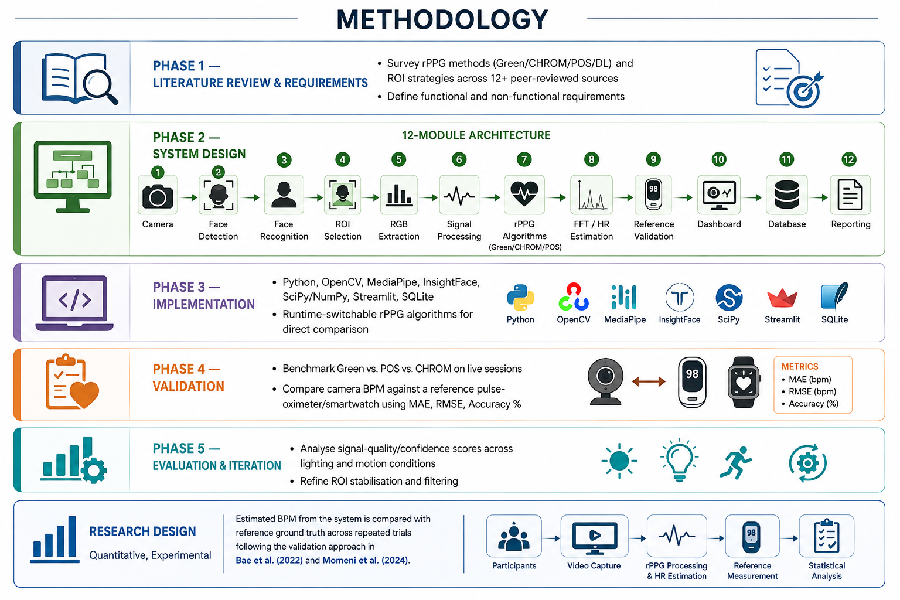
Project Methodology

Slide 8
Proposed Solution
HeartRateAI: a modular, real-time, contactless HR monitoring system using only a standard RGB webcam.
Pipeline: MediaPipe Face Mesh detects the face + 468 landmarks → stabilised forehead ROI is cropped → mean R/G/B extracted per frame into per-person buffers → detrend/normalise/Butterworth band-pass filter (0.7–4 Hz) → BVP recovered via switchable Green/CHROM/POS → FFT peak-frequency → BPM with a spectral confidence score.
Face recognition (InsightFace ArcFace, OpenCV LBPH fallback) auto-enrolls and identifies each user so readings are logged under the right name.
Optional validation against a Bluetooth HR strap or manual smartwatch entry computes MAE, RMSE, and Accuracy% per session.
Readings persist in SQLite; a live Streamlit dashboard shows video + ROI overlay, RGB/FFT plots, BPM, signal quality, plus searchable history and CSV/PDF export.

Slide 9


